Slide 1

SPCs before the UPC: Early Lessons from Merz v. Viatris
Matthieu DHENNE
Attorney-at-Law (Paris Bar)
UPC Representative
LES, Basel,
October 29, 2025

Slide 2

SPCs AND THE UPC
SPC: up to +5 years of additional protection for medicinal products; compensates regulatory approval delays
UPC competence: Art. 32(1) a) UPCA:
  "The Court shall have exclusive competence in respect of actions for actual or threatened infringements of patents and supplementary protection certificates and related defences, including counterclaims concerning licences."
Merz v. Viatris (UPC_CFI_697/2025): early SPC test case before the UPC

Slide 3
CASE OVERVIEW
Filing: 31 July 2025 – Paris Local Division
Product: Fampridine (Fampyra®)
Patent: EP 2 377 536 + SPC (until May 2026)
Parties: Merz Pharma v. Viatris Santé

Slide 4
PROCEDURAL INCIDENT AND PROPORTIONNALITY
Merz objected to a 470-page statement of defence filed by Viatris
17 September 2025 — Paris Local Division: case-management order based on the principle of proportionality; 70 pages per party imposed
10 October 2025 — preliminary injunction hearing
Decision expected: late November (around 20 November)
Takeaway: fast, disciplined, and fair process

Slide 5
MEANING OF PROPORTIONNALITY
Core EU-law principle ensuring fairness and balance
Drives case management: page limits, focused evidence, and time caps
Shapes the UPC’s procedural culture

Slide 6
STRATEGIC TAKEAWAYS FOR SPC LITIGANTS
Expect structured and swift proceedings
SPC disputes are manageable under tight page and time limits
Speed is balanced by fairness and the right to be heard
Opt-out remains a tactical lever; decide early based on risk profile

Slide 7
UPC AND PHARMA TODAY
Early pharma docket includes several biosimilar and SPC cases
Robust case management; orders illustrate a neutral and efficiency-driven approach
No clear bias: balanced outcomes
→ Efficient and neutral so far

Slide 8
CONCLUSION
UPC = efficiency, fairness, speed under control
UPC is building a truly European identity, language of its own
We must adapt: be concise, precise, and ready

Slide 9
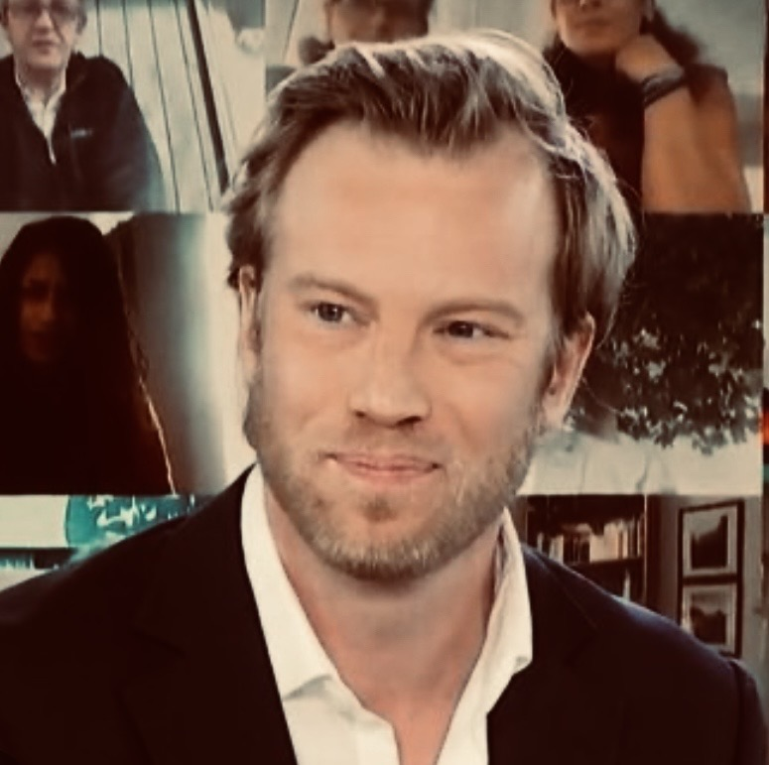
THANK YOU FOR YOUR ATTENTION!
Matthieu DHENNE
Attorney-at-Law (Paris Bar)
UPC Representative
md@dhenne-avocats.fr
+33 (0)6 95 44 20 38
DHENNE AVOCATS
7 rue Commines – 75003 Paris
Tel. +33 (0)1 71 60 61 46

