Slide 1
LES BASEL LIFE SCIENCE SERIES
SPCs before the UPC: early lessons from Merz v. Viatris
Matthieu Dhenne
Attorney-at-Law (Paris Bar)
UPC Representative
Basel
29 October 2025

Slide 2
SPCs and the UPC
SPC: up to five additional years of protection for medicinal products, compensating regulatory approval delays.
UPC COMPETENCE: ART. 32(1)(A) UPCA
“The Court shall have exclusive competence in respect of actions for actual or threatened infringements of patents and supplementary protection certificates and related defences, including counterclaims concerning licences.”
Merz v. Viatris (UPC_CFI_697/2025): an early SPC test case before the UPC.

Slide 3
Case overview
FILING
31 July 2025, Paris Local Division
PRODUCT
Fampridine (Fampyra®)
PATENT
EP 2 377 536 and SPC (until May 2026)
PARTIES
Merz Pharma v. Viatris Santé

Slide 4
Procedural incident and proportionality
Objection
Merz objected to a 470-page statement of defence filed by Viatris
17 September 2025
Paris Local Division: case-management order based on the principle of proportionality; 70 pages per party imposed
10 October 2025
Preliminary injunction hearing
Late November 2025
Decision expected (around 20 November)
Takeaway: a fast, disciplined and fair process

Slide 5
The meaning of proportionality
An EU-law principle
Case management
Procedural culture
Core EU-law principle ensuring fairness and balance
Drives case management: page limits, focused evidence and time caps
Shapes the UPC’s procedural culture

Slide 6
Strategic takeaways for SPC litigants
01
Expect structured and swift proceedings
02
SPC disputes are manageable under tight page and time limits
03
Speed is balanced by fairness and the right to be heard
04
Opt-out remains a tactical lever: decide early, based on the risk profile

Slide 7
The UPC and pharma today
Docket
Case management
Outcomes
The early pharma docket includes several biosimilar and SPC cases
Robust case management; orders illustrate a neutral, efficiency-driven approach
No clear bias: balanced outcomes, efficient and neutral so far

Slide 8
Conclusion
01
The UPC means efficiency, fairness and speed under control
02
The UPC is building a truly European identity, with a language of its own
03
We must adapt: be concise, precise and ready

Slide 9
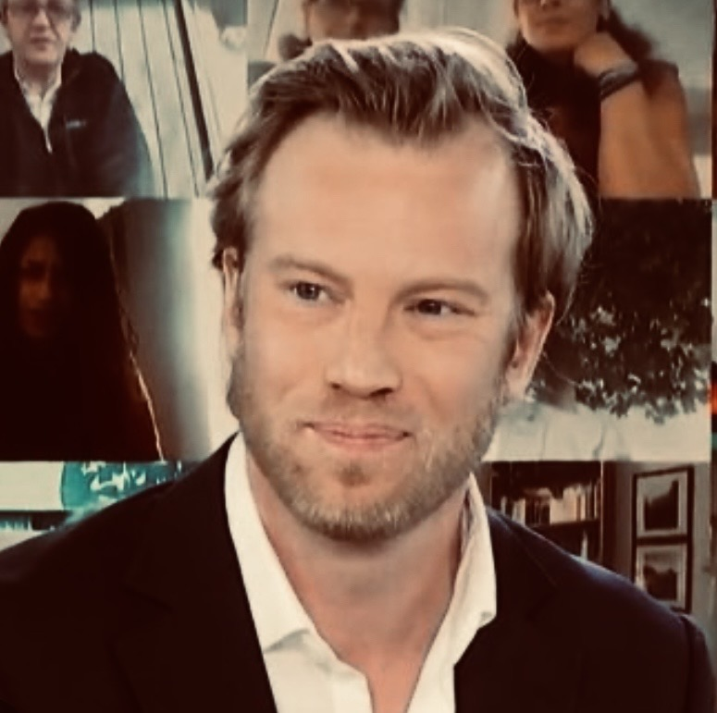
Thank you for your attention
Matthieu Dhenne
Attorney-at-Law (Paris Bar)
UPC Representative
md@dhenne-avocats.fr
7 rue Commines, 75003 Paris
+33 (0)1 71 60 61 46
www.dhenne-avocats.fr

