Slide 1
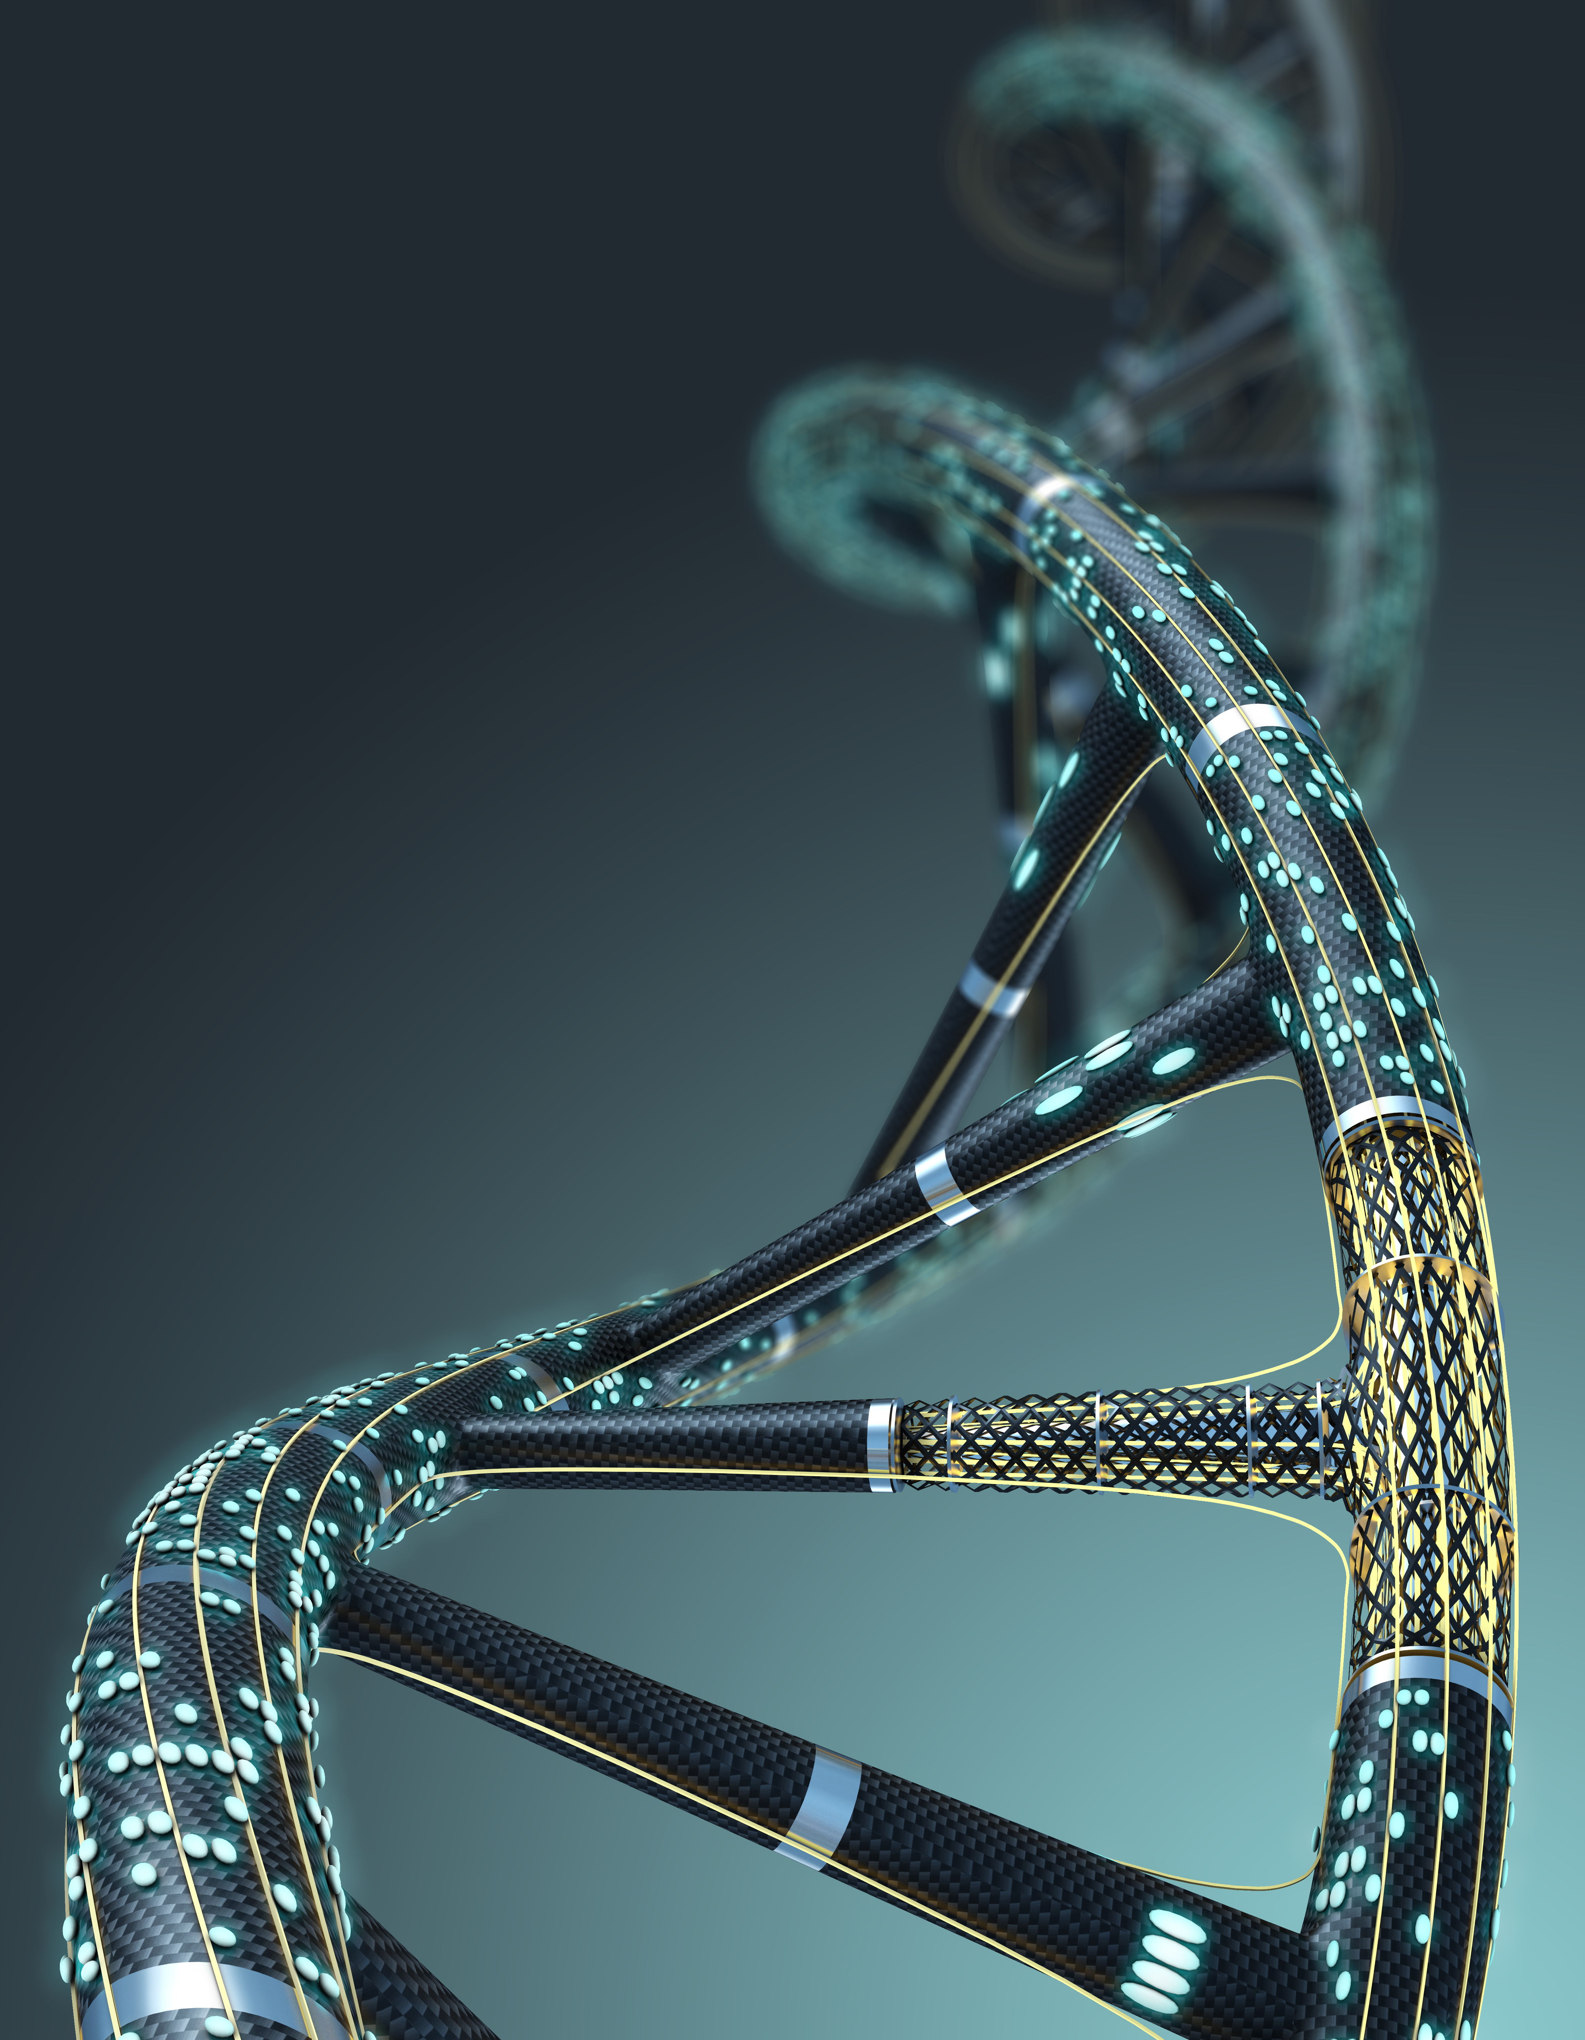
Recent development regarding SPC’s in France: the “avelumab” case
(Paris Court of Appeal, May 25, 2022)
MUNICH, OCTOBER 7, 2022
Dr. Matthieu Dhenne
Attorney-at-Law (Paris Bar)
7 rue Commines
75003 PARIS

Slide 2
FACTS OF AVELUMAB CASE
On 17 November 2017, application at the French PTO (INPI) for an SPC for avelumab based on European patent EP1210424 (“EP’424”) and on marketing authorisation (MA) EU/1/17/1214, granted on 20 September 2017 to Merck Europe B.V.
Avelumab is an anti-PD-L1 monoclonal antibody. It is the active ingredient of Bavencio® (Pfizer), which is indicated in the treatment of cancers.
EP’424 essentially relates to PD-L1, claimed as an isolated polypeptide (in claim 12). EP’424 also claims antibodies which selectively binds to PD-L1. However, avelumab is neither disclosed or claimed as such in EP’424.
On 3 February 2021, the INPI refused the SPC according to Article 3(a) of EU SPC Regulation because avelumab was not specifically identifiable, in the light of all the information disclosed by that patent.

Slide 3
MEDEVA
Article 3 [of the EU SPC Regulation]
Conditions for obtaining a certificate
“A certificate shall be granted if, in the Member State in which the application referred to in Article 7 is submitted and at the date of that application:
(a) the product is protected by a basic patent in force; […]”
In its landmark Medeva decision (C-322/10) the Court of Justice of the European Union (CJEU) interpreted the term “protected” as meaning that active ingredients must be specified in the wording of the claims.

Slide 4
ELI LILLY
In the later Eli Lilly decision (C-493/12), rendered on an antibody case.
where the active ingredient is covered by a functional formula in the claims, Article 3(a) does not preclude the grant of a supplementary protection certificate for that active ingredient;
but on condition that the claims relate, implicitly but necessarily and specifically, to the active ingredient in question.

Slide 5
ROYALTY PHARMA
More recently, in the Royalty Pharma decision (C-650/17), rendered on a small molecule case.
A product is protected by a basic patent in force if it corresponds to a general functional definition used by one of the claims, provided that it is specifically identifiable, in the light of all the information disclosed by that patent, by a person skilled in the art, based on that person’s general knowledge.
In contrast, product is not protected by a basic patent in force if, although it is covered by the functional definition given, it was developed after the filing date of the application for the basic patent, following an independent inventive step.

Slide 6
PREVIOUS FRENCH CASE LAW 1/2
In a case close to the avelumab case, the Paris Court of Appeal applied Royalty Pharma in a decision dated January 19, 2021.
SPC application FR15C0088 was filed on December 15, 2015, on the basis of (i) European patent EP1537878 (EP’878) patent and of (ii) a marketing authorization EU/1/15/1014 in the name of Bristol-Myers Squibb Pharma EEIG).
The product forming the subject-matter of the SPC is nivolumab (Opdivo®), a human monoclonal antibody which blocks the PD-1 receptor and is indicated in the treatment of certain cancers.
The EP’878 patent claims an anti-PD-1 antibody which inhibits the immunosuppressive signal of PD-1 for the use in cancer treatment. Nivolumab is not disclosed.

Slide 7
PREVIOUS FRENCH CASE LAW 2/2
The INPI refused the SPC because:
while claim 3 did “implicitly” cover nivolumab, it could not be interpreted in the light of the description of the basic patent as relating “necessarily” and “specifically” to this active ingredient within the meaning of the judgement of the CJEU in case C‑493/12 (Eli Lilly)
as the description of the patent did not contain any indication, such as a concrete embodiment or any other teaching allowing to specifically individualise nivolumab. The Paris Court of Appeal confirmed the refusal.
The Cour d’appel notably considered that the fact that 3 years were necessary to file the later EP’336 patent which specifically relates to nivolumab was a sound indication that an independent inventive step was needed from the EP’878 patent to arrive at nivolumab.

Slide 8
NEW FRENCH CASE LAW 1/2
In the present avelumab case, on May 25, 2022, the Paris Court of Appeal reversed the decision of the INPI.
This is a feat in itself, as in SPC matters the Paris Cour d’appel usually sides with the INPI (11 times out of 11 of the previous cases we followed).
Applying the practice of the EPO, the Cour d’appel considered that methods for the generation and identification of an antibody directed against a given antigen are routine techniques, consequently, when the antigen is already known, the discovery of an antibody that binds to this antigen does not involve an inventive step.

Slide 9
NEW FRENCH CASE LAW 2/2
For the Court of Appeal the human monoclonal antibody avelumab was specifically identifiable in light of EP’424 patent by a person skilled in the art, using known and mastered routine tests, which can be long and tedious, but do not result in an autonomous inventive step.
The interpretation of the Royalty Pharma case law by the Paris Cour d’appel somewhat lowers the bar set by the Medeva case law (protected = specified) for antibodies.
Patents covering a novel antigen and claiming antibodies to that antigen could more frequently yield SPCs for monoclonal antibodies to that antigen prepared after the filing date of the patent.

